Slide 1
Image classification with MEMEs
Prasanna Kumar K
Rahul P

Slide 2
Content:
Introduction
Why?
Dataset
Models
Result
Code

Slide 3
Introduction : )
We used image classification to address the difficulties involved in the classification of troll memes with the existing methods.
We used machine learning, deep learning and some feature extraction
Form these model we produce the output in the format of precision, recall and fi-score.

Slide 4
Why?
Social media are interactive platforms that facilitate the creation or sharing of information, ideas or other forms of expression among people.
This exchange is not free from offensive, trolling or malicious contents targeting users or communities.
One way of trolling is by making memes, which in most cases combines an image with a concept or catchphrase.
The challenge of dealing with memes is that they are region-specific and their meaning is often obscured in humour or sarcasm. To facilitate the computational modelling of trolling in the memes for Indian languages. We found the meme dataset for tamil(tamil memes).

Slide 5
Dataset:
This dataset contains meme database include trolling and this having to labels
Total : 2300
Troll = 1282
Not troll = 1018
This dataset was collected from social media platform like facebook, whatsapp, instagram, and pinterest.
This datasets doesn't have any duplicate memes, however, if it is memes that uses the same image but different text.

Slide 6
Models
Preprocessing
Resizing image
Gaussian blur
Feature extraction
Grayscale
Threshold-
Threshold
Threshold binary
Threshold binary inverted
Machine learning
K-nearest neighbours algorithm
Support Vector Machine
Deep learning
CNN for image
LSTM for text
CNN+LSTM to dense layer

Slide 7
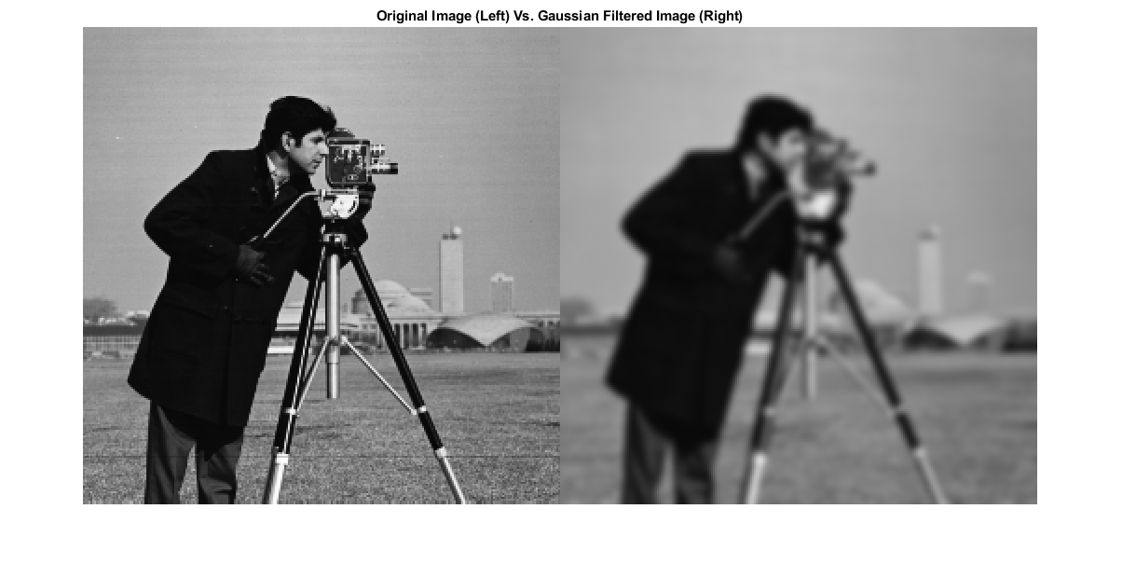

Slide 8
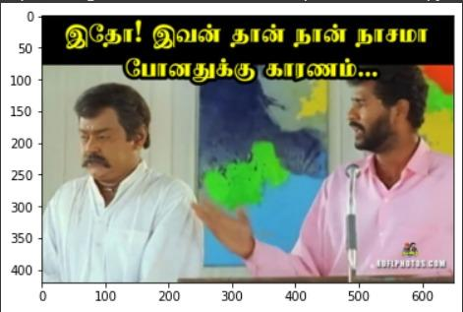
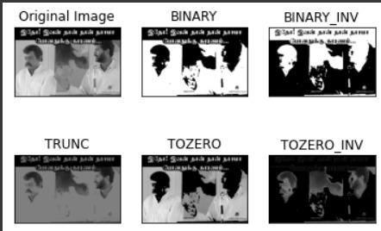

Slide 9
Machine learning results
https://docs.google.com/document/d/1T3L2phKEq7jl2QQoHJJGTod6mNPWJkePj88DQi-sDy8/edit?usp=sharing
Deep Learning result
https://docs.google.com/document/d/1xOYACrdpNDeKoxLFibfT2-kmKnBBt6J_Y9swxoQ7MyY/edit?usp=sharing

Slide 10
Code:
Deep Learning
Machine learning

